Slide 1
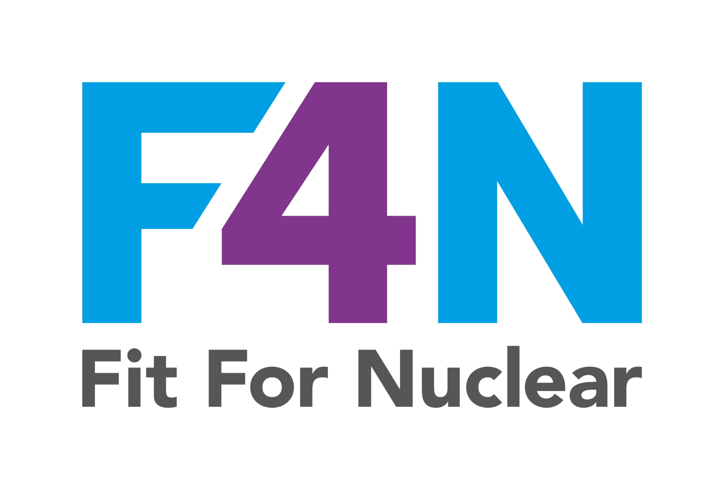

Introduction to Nuclear
Supply Chain Requirements
What every supplier needs to know before working in nuclear
NSS-06-PP-01 | Nuclear Sector Specific | Supply Chain Readiness
NucCol | Nuclear Collaboration Ltd
NucCol | Nuclear Collaboration Ltd · Fit For Nuclear Programme · Commercial in Confidence | 1

Slide 2
Session Overview
01
Why nuclear procurement is different from standard commercial buying
02
The UK regulatory landscape: ONR, TAG 77 and ISO 19443
03
Quality grading: classifying items by safety significance
04
Writing effective nuclear procurement specifications
05
Approved Supplier Lists and supplier qualification requirements
06
Counterfeit, Fraudulent and Suspect Items (CFSI) controls
07
Records, documentation and traceability requirements
NucCol | Nuclear Collaboration Ltd · Fit For Nuclear Programme · Commercial in Confidence | 2

Slide 3
Why Nuclear Procurement Is Different
The Core Differences
What This Means for You
Consequences of failure can directly affect nuclear safety and public protection
Items are often safety-critical, with no margin for latent defects
Legal obligations under the Nuclear Installations Act
Regulatory oversight by ONR with right of access to the entire supply chain
Buyers must maintain an "Intelligent Customer" capability at all times
Records must prove every step of the process, not just the final outcome
Requirements do not stop at tier one: they flow through every subcontractor
Safety culture is assessed, not just quality management system compliance
NucCol | Nuclear Collaboration Ltd · Fit For Nuclear Programme · Commercial in Confidence | 3

Slide 4
The UK Nuclear Regulatory Framework
TAG 77
ISO 19443
UK Good Practice Guide
ONR Technical Assessment Guide
Nuclear QMS Standard
Supply Chain Quality Requirements (2018)
Defines ONR expectations for supply chain management for nuclear safety-related items. Covers specification, supplier evaluation, quality plans, inspection, CFSI and operational experience. The benchmark for what nuclear buyers expect.
Extends ISO 9001 for the nuclear sector. Addresses nuclear safety culture, graded quality management, CFSI controls and management of nuclear safety significant activities. Increasingly required by major buyers.
Published by the Nuclear Industry Safety Directors Forum. Practical guidance on quality grading, supplier qualification, ITPs, records management and performance measurement.
NucCol | Nuclear Collaboration Ltd · Fit For Nuclear Programme · Commercial in Confidence | 4

Slide 5
Quality Grading in Nuclear Procurement
Graded quality management: the most rigorous controls are applied where the consequences of failure are greatest.
Controls Required
NSC1
Highest Safety Significance
Full nuclear quality programme, ITP, third-party inspection, extensive records
Failure directly causes or contributes to a nuclear accident
NSC2
Important to Safety
Quality plan, ITP, approved supplier, documented inspection
Failure could impair nuclear safety functions
NSC3
Safety Related
Documented procurement, approved supplier, receiving inspection
Some nuclear significance, controlled accordingly
NN
Non-Nuclear
Standard commercial procurement with basic quality records
No nuclear safety significance
NucCol | Nuclear Collaboration Ltd · Fit For Nuclear Programme · Commercial in Confidence | 5

Slide 6
Counterfeit, Fraudulent and Suspect Items (CFSI)
CFSI are items misrepresented as to their identity, origin or quality. They may appear to meet specification while being fundamentally incapable of performing their intended safety function.
WARNING SIGNS
MITIGATION CONTROLS
Items with unusually short lead times or prices significantly below market rate
Suppliers unable or unwilling to provide full material traceability
Items from online marketplaces or brokers without nuclear credentials
Inconsistent markings, poor packaging or documentation that does not match the item
Specify OEM or authorised distributor sourcing in every nuclear purchase order
Require full material traceability from mill certificate to delivery
Apply positive material identification (PMI) testing for at-risk items
Train purchasing staff to recognise warning signs and raise concerns
NucCol | Nuclear Collaboration Ltd · Fit For Nuclear Programme · Commercial in Confidence | 6

Slide 7
Approved Supplier List: What It Means in Practice
1. Pre-Qualification
2. Qualification Audit
3. Approval Decision
4. ASL Entry
5. Ongoing Oversight
Supplier completes a structured questionnaire covering QMS, technical capability, nuclear experience, financial status and CFSI controls
On-site or remote audit by a qualified lead auditor. Findings classified as Major NC, Minor NC or Observation
Quality authority reviews audit report and grants Full, Conditional or Provisional approval, or declines
Supplier added to ASL with defined scope, grade and approval period. Conditions and contacts recorded
Annual certification check, performance review, periodic re-audit (12-24 months depending on grade). Triggered review on significant events
NucCol | Nuclear Collaboration Ltd · Fit For Nuclear Programme · Commercial in Confidence | 7

Slide 8
Records and Documentation: The Nuclear Standard
In nuclear: if it is not documented, it did not happen. Records are safety evidence, not administrative overhead.
Purchase order and specification
Supplier qualification records
What was ordered and to what requirement
Evidence the supplier was assessed and approved
Approved quality plan
ITP with completed sign-offs
The inspection and control regime for the contract
Evidence inspections were conducted at each stage
Material certificates
Non-conformance records
Traceability from raw material to finished item
Any deviations and their authorised disposition
Certificate of conformance
Goods receipt inspection record
Supplier's formal declaration of conformance
Verification of conformance at delivery
NucCol | Nuclear Collaboration Ltd · Fit For Nuclear Programme · Commercial in Confidence | 8

Slide 9
Key Messages
01
Understand the requirement
Nuclear buyers expect comprehensive, documented procurement controls, not just ISO 9001 certification
02
Grade everything
Classify every item and service by nuclear safety significance before you decide what controls to apply
03
Flow down completely
Your nuclear requirements must flow to every subcontractor that contributes to your delivery
04
Control CFSI risk
Train your people, source from authorised channels and verify traceability at every step
05
Record everything
For nuclear safety-significant items, records may be retained for the life of the plant and beyond
NucCol | Nuclear Collaboration Ltd · Fit For Nuclear Programme · Commercial in Confidence | 9

